Slide 1
Green Accounting
GDP and its discontents
Productivity growth
Environmental product, theory
… and practice
Genuine savings
Alternative indicators
Ecological footprint
Corporate accounting

Slide 2
0 Introduction
1 Social choice
2 Externalities and public goods
3 Decision analysis
4 Valuation: Aims and purpose
5 Valuation: Revealed preferences
6 Valuation: Stated preferences
7 Direct regulation
8 Market-based instruments
9 Growth and justice
10 Green accounting
11 Exam preparation

Slide 3
Green Accounting
GDP and its discontents
Productivity growth
Environmental product, theory
… and practice
Genuine savings
Alternative indicators
Ecological footprint
Corporate accounting

Slide 4
Gross Domestic Production
Gross Domestic Product is the conventional measure of economic performance, tracking the economy over time and, per capita, comparing economies over space
Originally proposed by Simon Kuznets in 1925
“the welfare of a nation can scarcely be inferred from a measurement of national income” – Kuznets, 1932
GDP is a measure of economic activity
Notes:
Motivation for today’s lecture?
If you follow the news at all, you’ll hear a lot about three of the conventional measures of economic performance:
unemployment
inflation
and especially, GDP
Declining GDP means recession;
rising GDP is economic growth,
and economic growth is almost always presented as a wholly positive thing, and as a major goal of policy

Slide 5
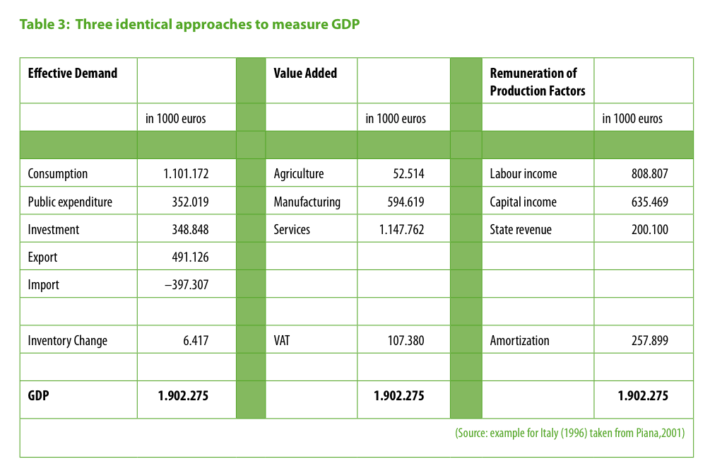
alternative
in million €
in million €
in million €
Notes:
GDP can be measured three ways.
By adding up all expenditure on goods and services (col 1)
By adding up the value added by labour and capital in transforming inputs into outputs (col 2)
- By adding up income received from the production of goods and services:
wages that compensate labour, rent as payment for resources, and profit as reward for entrepreneurial risk-taking (col 3)
Should all come to the same figure. Snapshot of macroeconomic activity.
Italy 1996.
GDP just short of €2tn.

Slide 6
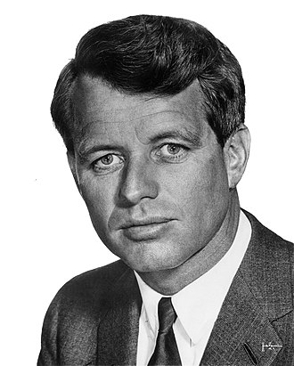
Too much and for too long, we seemed to have surrendered personal excellence and community values in the mere accumulation of material things. Our Gross National Product, now, is over $800 billion dollars a year, but that Gross National Product […] counts air pollution and cigarette advertising, and ambulances to clear our highways of carnage. It counts special locks for our doors and the jails for the people who break them. It counts the destruction of the redwood and the loss of our natural wonder in chaotic sprawl. It counts napalm and counts nuclear warheads and armored cars for the police to fight the riots in our cities. It counts Whitman’s rifle and Speck's knife, and the television programs which glorify violence in order to sell toys to our children.
Yet the gross national product does not allow for the health of our children, the quality of their education or the joy of their play. It does not include the beauty of our poetry or the strength of our marriages, the intelligence of our public debate or the integrity of our public officials. It measures neither our wit nor our courage, neither our wisdom nor our learning, neither our compassion nor our devotion to our country, it measures everything in short, except that which makes life worthwhile. And it can tell us everything about America except why we are proud that we are Americans.
Robert F. Kennedy, U Kansas, 18 March 1968

Slide 7
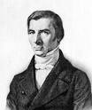
Why not GDP?
Investment but not depreciation
Broken window fallacy
Net Domestic Product
Limited to market transactions
Housework
Subsistence farming
Defensive expenditure
Crime
Environment
…
Distribution of income
Freedom
Notes:
Motivation for today’s lecture?
If you follow the news at all, you’ll hear a lot about three of the conventional measures of economic performance:
unemployment
inflation
and especially, GDP
Declining GDP means recession;
rising GDP is economic growth,
and economic growth is almost always presented as a wholly positive thing, and as a major goal of policy

Slide 8
Green Accounting
GDP and its discontents
Productivity growth
Environmental product, theory
… and practice
Genuine savings
Alternative indicators
Ecological footprint
Corporate accounting

Slide 9
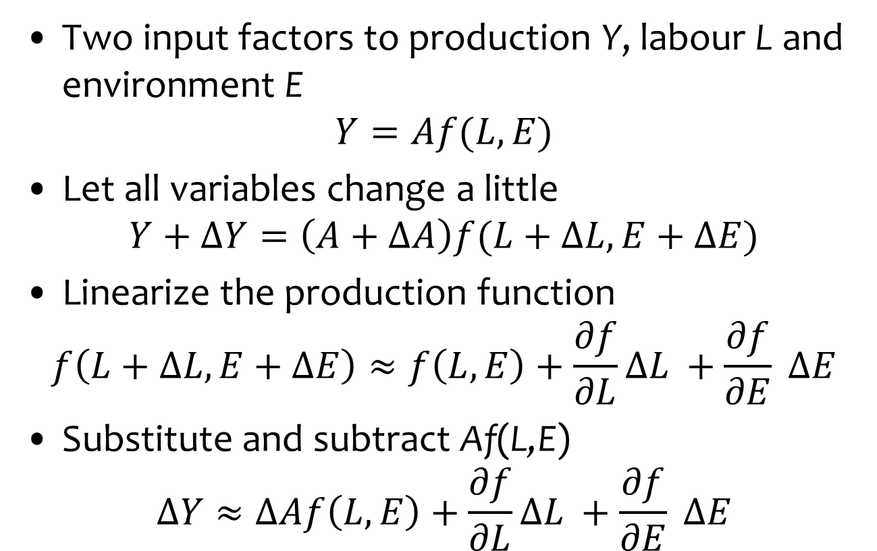
Measuring Productivity Growth
Two input factors to production Y, labour L and environment E
$$Y=Af(L,E)$$
Let all variables change a little
$$Y+ΔY=\left(A+ΔA\right)f(L+ΔL,E+ΔE)$$
Linearize the production function
$$f\left(L+ΔL,E+ΔE\right)≈f\left(L,E\right)+\frac{∂f}{∂L}ΔL +\frac{∂f}{∂E} ΔE$$
Substitute and subtract Af(L,E)
$$ΔY≈ΔAf\left(L,E\right)+\frac{∂f}{∂L}ΔL +\frac{∂f}{∂E} ΔE$$

Slide 10

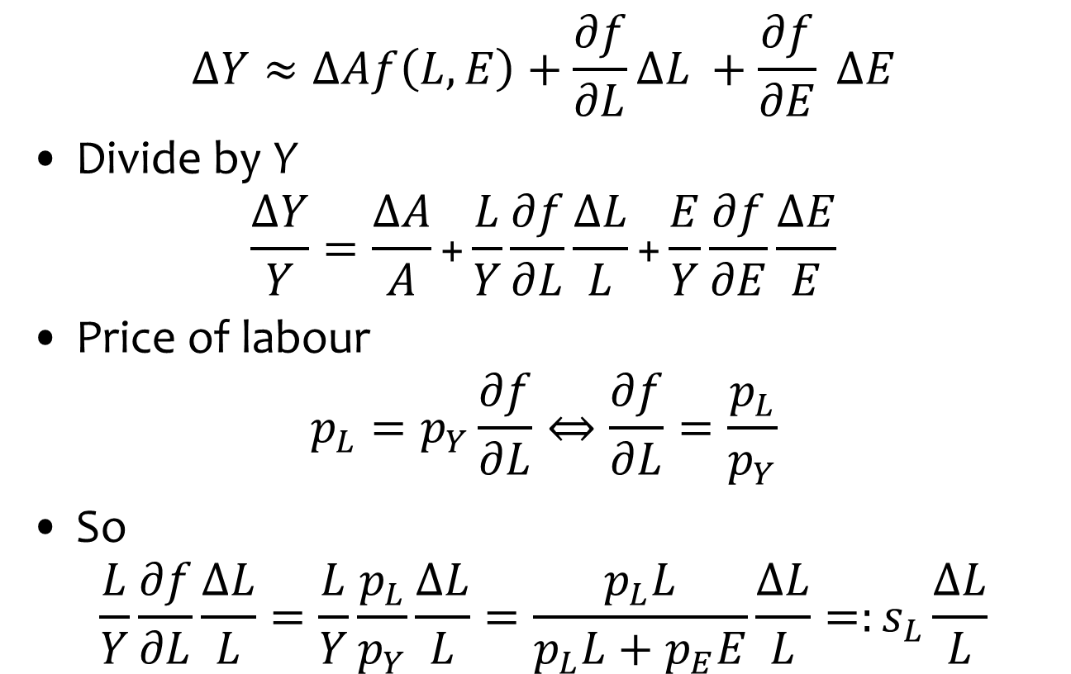
Measuring Productivity Growth
$$ΔY≈ΔAf\left(L,E\right)+\frac{∂f}{∂L}ΔL +\frac{∂f}{∂E} ΔE$$
Divide by Y
$$\frac{ΔY}{Y}=\frac{ΔA}{A}\text{+}\frac{L}{Y}\frac{∂f}{∂L}\frac{ΔL}{L}\text{+}\frac{E}{Y}\frac{∂f}{∂E}\frac{ΔE}{E}$$
Price of labour
$$p_{L}=p_{Y}\frac{∂f}{∂L}⇔\frac{∂f}{∂L}=\frac{p_{L}}{p_{Y}}$$
So
$$\frac{L}{Y}\frac{∂f}{∂L}\frac{ΔL}{L}=\frac{L}{Y}\frac{p_{L}}{p_{Y}}\frac{ΔL}{L}=\frac{p_{L}L}{p_{L}L+p_{E}E}\frac{ΔL}{L}=:s_{L}\frac{ΔL}{L}$$
$$Y=Af(L,E)$$

Slide 11
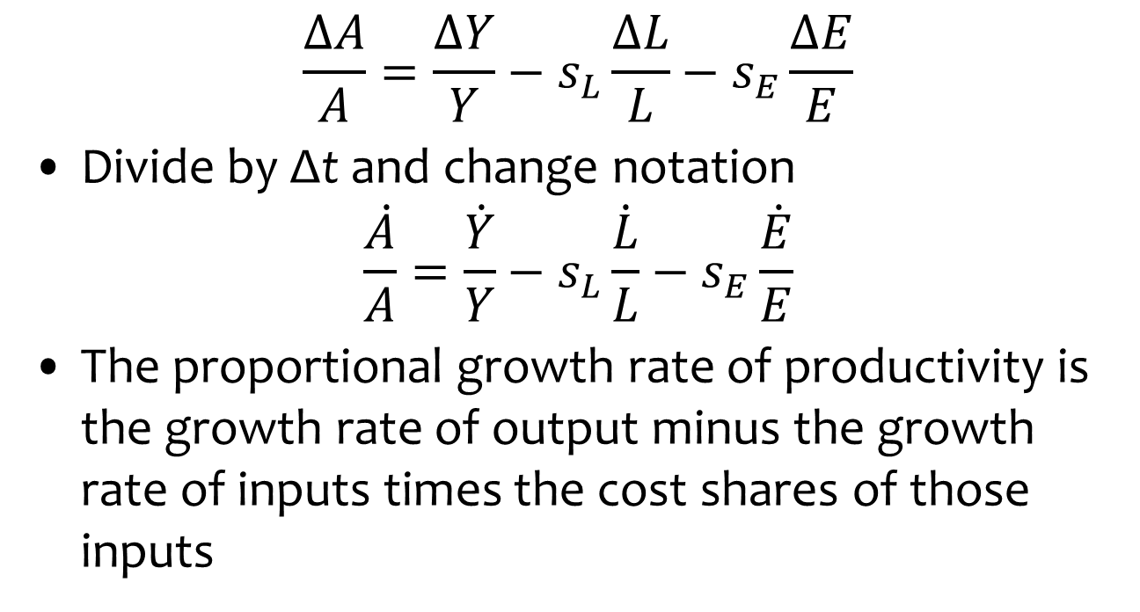
Measuring Productivity Growth
$$\frac{ΔA}{A}=\frac{ΔY}{Y}−s_{L}\frac{ΔL}{L}−s_{E}\frac{ΔE}{E}$$
Divide by Δt and change notation
$$\frac{\dot{A}}{A}=\frac{\dot{Y}}{Y}−s_{L}\frac{\dot{L}}{L}−s_{E}\frac{\dot{E}}{E}$$
The proportional growth rate of productivity is the growth rate of output minus the growth rate of inputs times the cost shares of those inputs

Slide 12
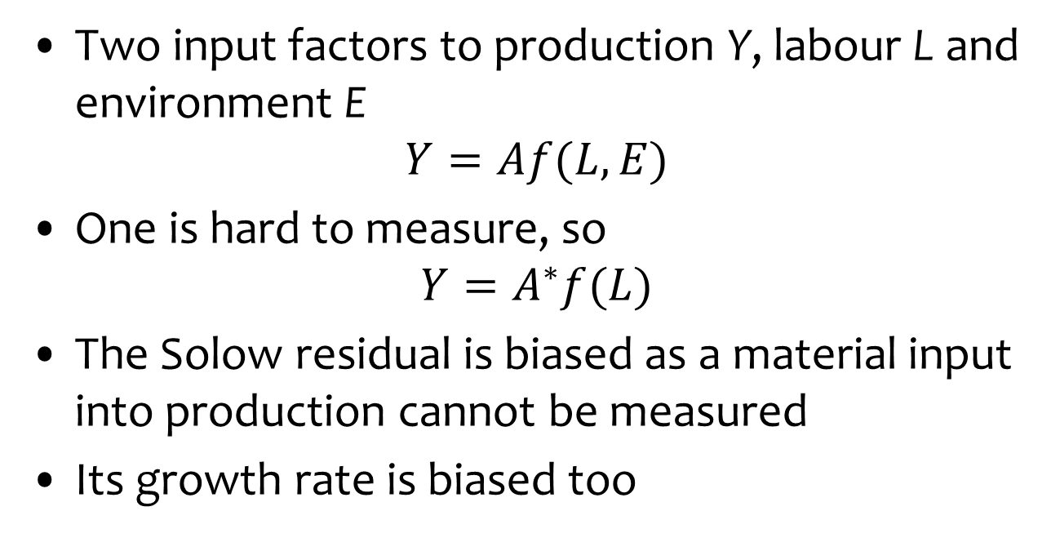
Mismeasuring Productivity Growth
Two input factors to production Y, labour L and environment E
$$Y=Af(L,E)$$
One is hard to measure, so
$$Y=A^{∗}f(L)$$
The Solow residual is biased as a material input into production cannot be measured
Its growth rate is biased too

Slide 13
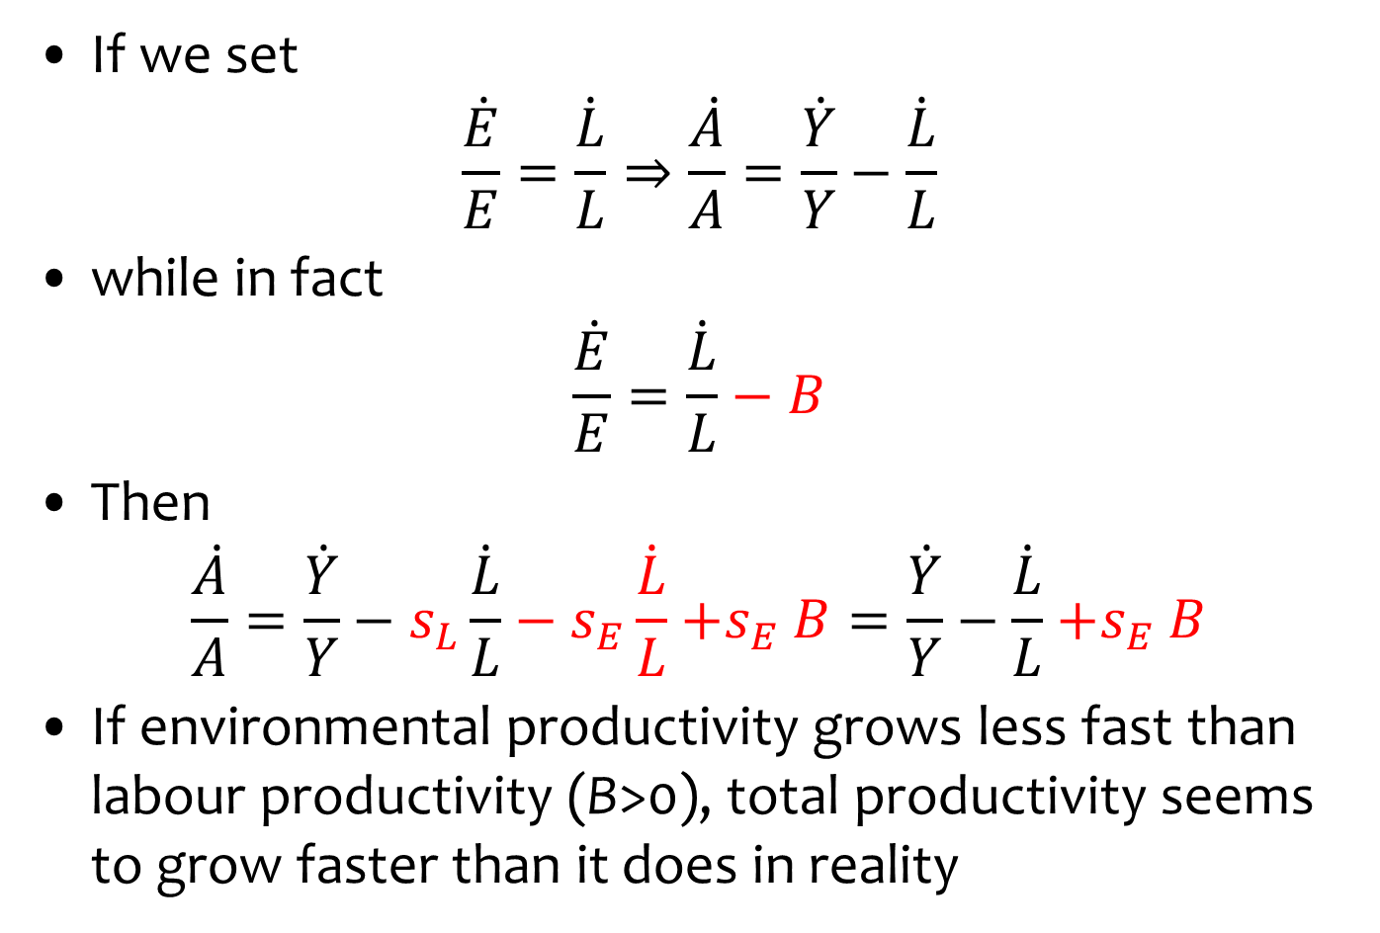
Mismeasuring Productivity Growth
If we set
$$\frac{\dot{E}}{E}=\frac{\dot{L}}{L}⇒\frac{\dot{A}}{A}=\frac{\dot{Y}}{Y}−\frac{\dot{L}}{L}$$
while in fact
$$\frac{\dot{E}}{E}=\frac{\dot{L}}{L}−B$$
Then
$$\frac{\dot{A}}{A}=\frac{\dot{Y}}{Y}−s_{L}\frac{\dot{L}}{L}−s_{E}\frac{\dot{L}}{L}{+s}_{E}B=\frac{\dot{Y}}{Y}−\frac{\dot{L}}{L}{+s}_{E}B$$
If environmental productivity grows less fast than labour productivity (B>0), total productivity seems to grow faster than it does in reality

Slide 14
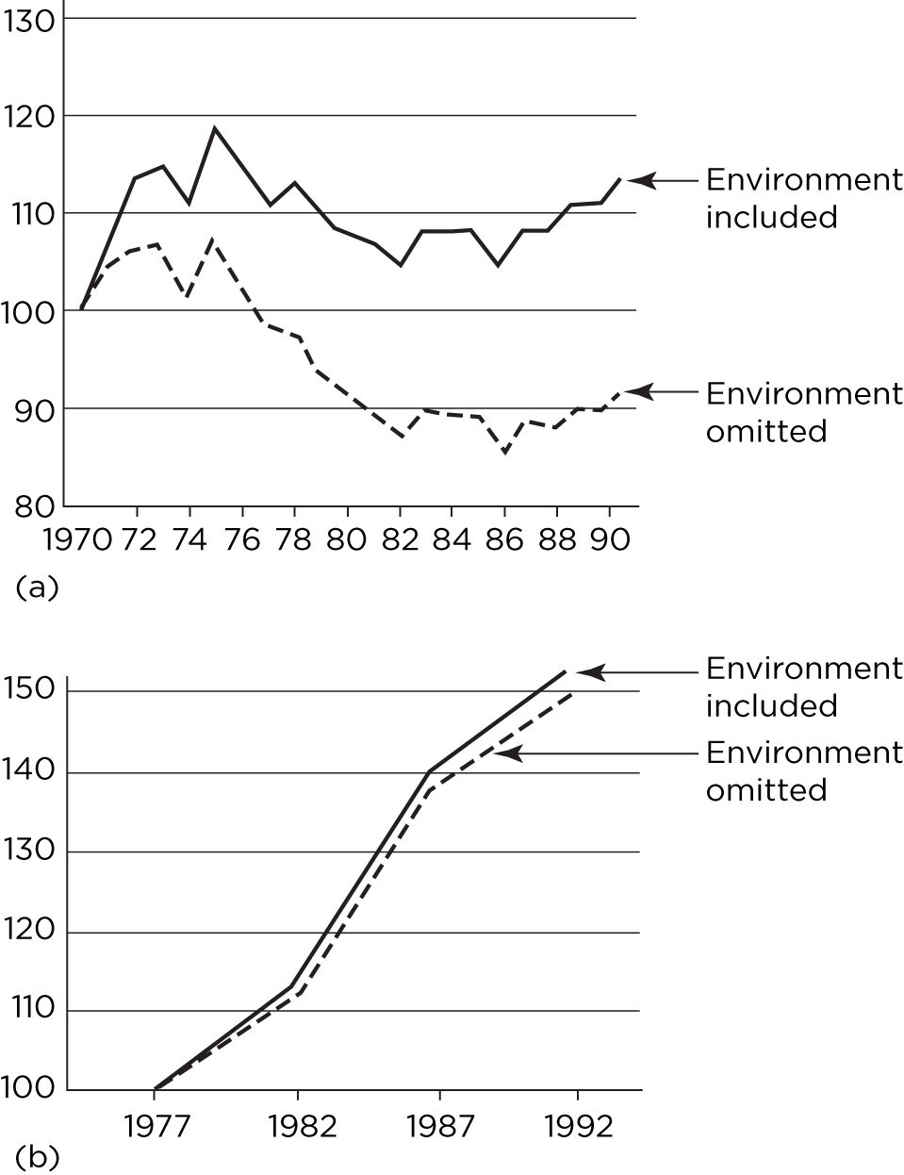
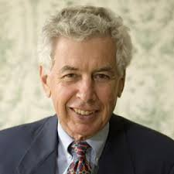
Total factor productivity
growth, with and without
environment, by sector
(top: electricity, bottom:
agriculture), USA
Growth is faster if
environment included –
because environment
got rapidly cleaner.

Slide 15
Green Accounting
GDP and its discontents
Productivity growth
Environmental product, theory
… and practice
Genuine savings
Alternative indicators
Ecological footprint
Corporate accounting

Slide 16
Notes:
Finally, changes in capital stocks, including natural capital, are not reflected. Environmental degradation and resource depletion are not accounted for.
(Which is really the same point we saw Stiglitz making about assets and liabilities just now, but since this is an env econ course it bears picking out specifically).

Slide 17
Environmental Net Domestic Product
GDP = C + I
NDP = C + I – D
EDP = C + I – D + P – N
Notes:
So how is that operationalised?
Saw that GDP is consumption + gross investment.
Net Domestic Product — as perhaps implied by that point about GDP, subtracts capital depreciation from GDP.
But before we get excited, that’s not all kinds of capital. It’s just fixed or manufactured capital: vehicles, machinery, and so on.
In the last 10 years NDP has been about 15% lower than GDP for European countries. The difference has increased with increasing technological development because capital — especially hardware and software — becomes obsolete and needs replacing frequently.
(Why not used instead of GDP? Eurostat: “Consumption of fixed capital is one of the most difficult national accounts concepts to measure, so GDP is usually preferred for pragmatic reasons.”
— So even dm, depreciation of manufactured capital, is hard to measure — and that, in principle, has market prices.
But for a sustainability measure, this depreciation isn’t nearly enough. What if we’re digging non-renewable resources such as coal out of the ground, and harvesting a renewable resource such as fish faster than it can regenerate?
We should account for depreciation of our natural capital too. If we subtract this, this gives us our sustainable income — our quote from Hicks.
So that’s a sustainable income measure. Now what about changes in total wealth or capitals? Well, just subtract C.
Now — we talked earlier in this module about environmental valuation … but effectively, valuation on this scale — dn, encompassing literally everything — is impossible.
So what people have done is calculate measures based on these ideas. Because we cannot practically value everything, these measures are not complete. On the other hand, in some cases these measures try to fix some of the other shortcomings of GDP too.

Slide 18
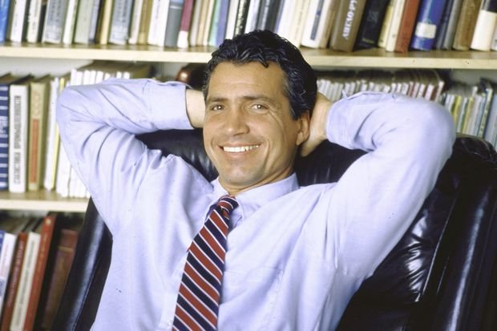
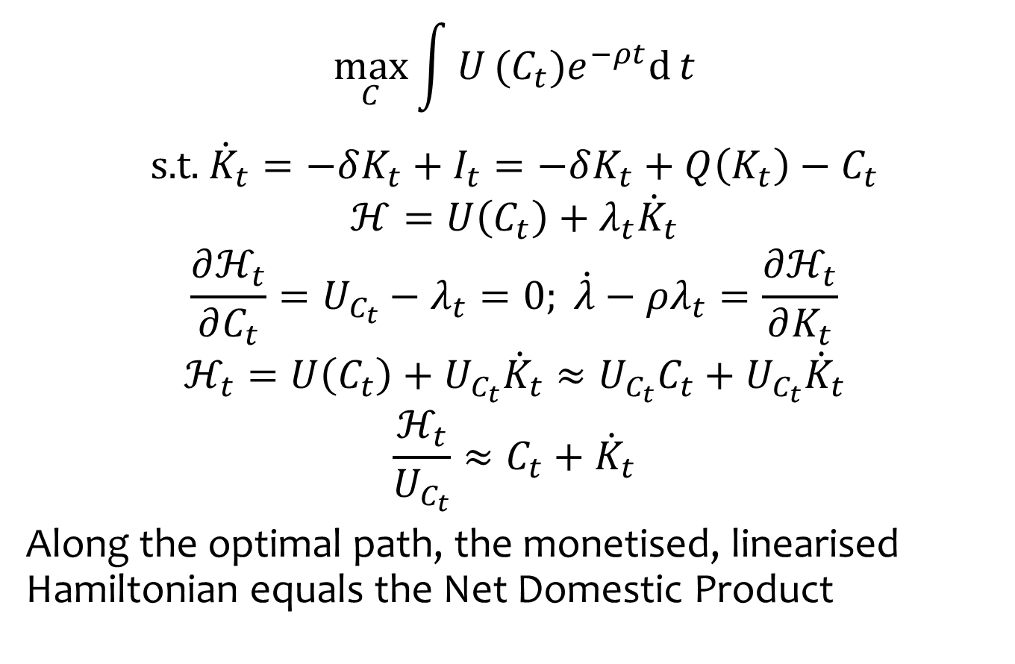
Welfare significance of national product
$$\max_{C}\int{U}(C_{t})e^{−ρt}\text{d}{t}$$
$$\text{s}\text{.}\text{t}\text{.} { \dot{K}}_{t}=−δK_{t}+I_{t}=−δK_{t}+Q\left(K_{t}\right)−C_{t}$$
$$ℋ=U\left(C_{t}\right)+λ_{t}{\dot{K}}_{t}$$
$$\frac{∂ℋ_{t}}{∂C_{t}}=U_{C_{t}}−λ_{t}=0; \dot{λ}−ρλ_{t}=\frac{∂ℋ_{t}}{∂K_{t}}$$
$$ℋ_{t}=U\left(C_{t}\right)+U_{C_{t}}{\dot{K}}_{t}≈U_{C_{t}}C_{t}+U_{C_{t}}{\dot{K}}_{t}$$
$$\frac{ℋ_{t}}{U_{C_{t}}}≈C_{t}+{\dot{K}}_{t}$$
Along the optimal path, the monetised, linearised Hamiltonian equals the Net Domestic Product

Slide 19

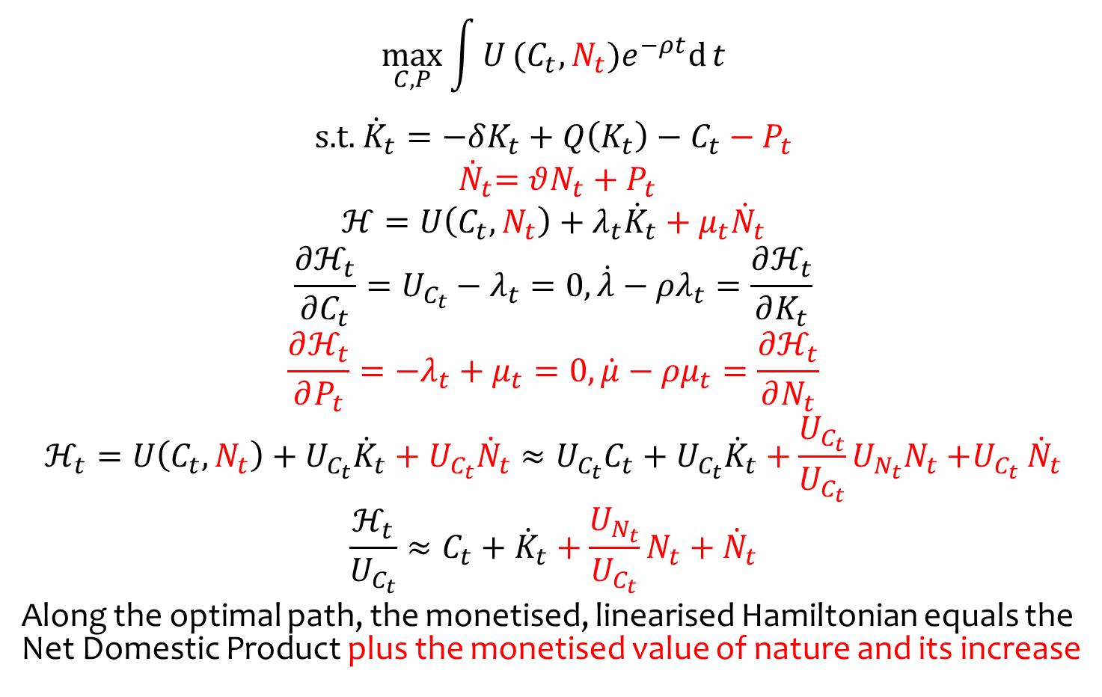
with nature and protection
$$\max_{C,P}\int{U}(C_{t},N_{t})e^{−ρt}\text{d}{t}$$
$$\text{s}\text{.}\text{t}\text{.} { \dot{K}}_{t}=−δK_{t}+Q\left(K_{t}\right)−C_{t}−P_{t}$$
$${ \dot{N}}_{t}=θN_{t}+P_{t}$$
$$ℋ=U\left(C_{t},N_{t}\right)+λ_{t}{\dot{K}}_{t}+μ_{t}{\dot{N}}_{t}$$
$$\frac{∂ℋ_{t}}{∂C_{t}}=U_{C_{t}}−λ_{t}=0, \dot{λ}−ρλ_{t}=\frac{∂ℋ_{t}}{∂K_{t}}$$
$$\frac{∂ℋ_{t}}{∂P_{t}}=−λ_{t}+μ_{t}=0, \dot{μ}−ρμ_{t}=\frac{∂ℋ_{t}}{∂N_{t}}$$
$$ℋ_{t}=U\left(C_{t},N_{t}\right)+U_{C_{t}}{\dot{K}}_{t}+U_{C_{t}}{\dot{N}}_{t}≈U_{C_{t}}C_{t}+U_{C_{t}}{\dot{K}}_{t}+\frac{U_{C_{t}}}{U_{C_{t}}}U_{N_{t}}N_{t}{+U}_{C_{t}}{\dot{N}}_{t}$$
$$\frac{ℋ_{t}}{U_{C_{t}}}≈C_{t}+{\dot{K}}_{t}+\frac{U_{N_{t}}}{U_{C_{t}}}N_{t}+{\dot{N}}_{t}$$
Along the optimal path, the monetised, linearised Hamiltonian equals the Net Domestic Product plus the monetised value of nature and its increase

Slide 20
Measure of Economic Welfare
Nordhaus & Tobin, 1972
Measure of consumption
not production
MEW = NDP – economic ‘bads’ (repairs, pollution control) – regrettable necessities (police, defense) + household & illegal production, leisure
‘Primitive & experimental’
But influential, incarnated as the index of sustainable economic welfare / genuine progress indicator / sustainable net benefit index / measure of domestic progress
Annuity of services by durables, human capital
Notes:
First sustainable income-like measure: MEW/ISEW.
NEF & Friends of the Earth keen

Slide 21
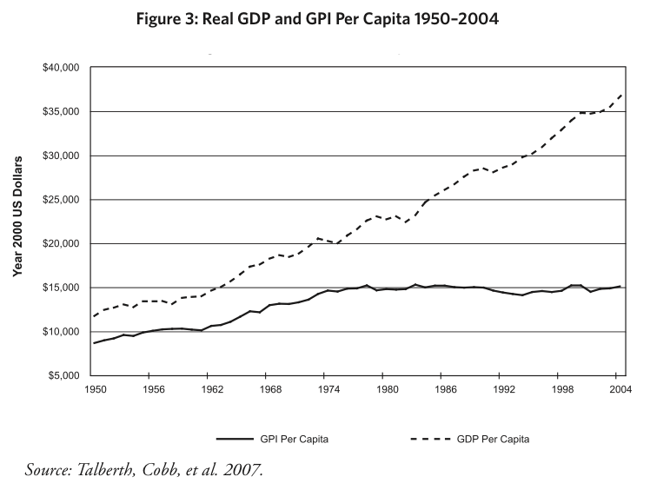
Notes:
Nice thing: easily comprehensible and GDP-like, so you can do this kind of thing (US data)
Threshold effect? Manfred Max-Neef, 1995

Slide 22
Limitations
Valuation issues
Depletion of non-renewables
Cumulative costs of environmental damage
Somewhat arbitrary
What expenditure is defensive? How bad is inequality?
Therefore manipulable
Weak sustainability
adding and subtracting capitals
what affects current welfare need not affect strong sustainability, and vice versa
Notes:
Economists hate it

Slide 23
Green Accounting
GDP and its discontents
Productivity growth
Environmental product, theory
… and practice
Genuine savings
Alternative indicators
Ecological footprint
Corporate accounting

Slide 24
Office of National Statistics
ONS publishes the UK Environmental Accounts and the UK Natural Capital Accounts
Environmental Accounts
Limited to emissions to air – no water, soil
Heavy emphasis on energy and carbon dioxide – political priority, but ONS supposedly neutral
Particulates, heavy metals
Expenditure on environmental protection
Environmental tax revenue
Materials flow accounts
No valuation
Notes:
Motivation for today’s lecture?
If you follow the news at all, you’ll hear a lot about three of the conventional measures of economic performance:
unemployment
inflation
and especially, GDP
Declining GDP means recession;
rising GDP is economic growth,
and economic growth is almost always presented as a wholly positive thing, and as a major goal of policy

Slide 25
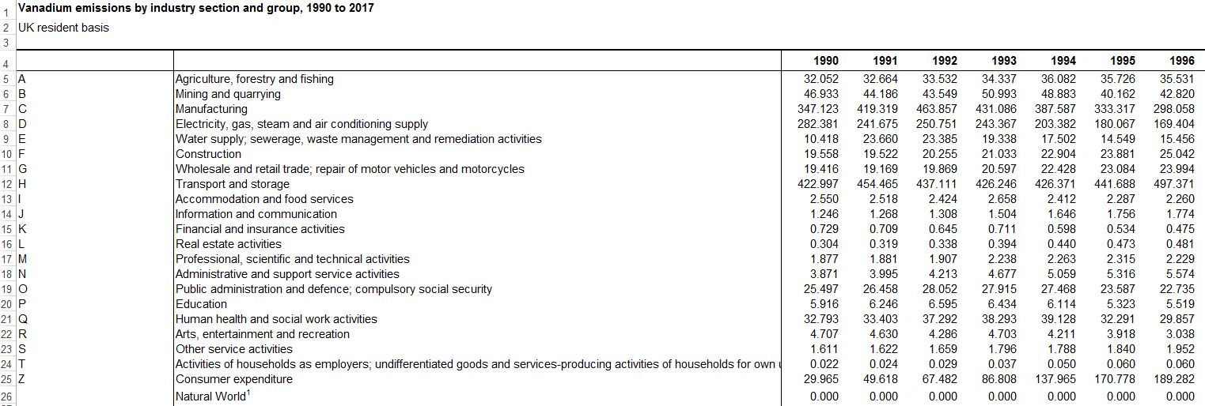
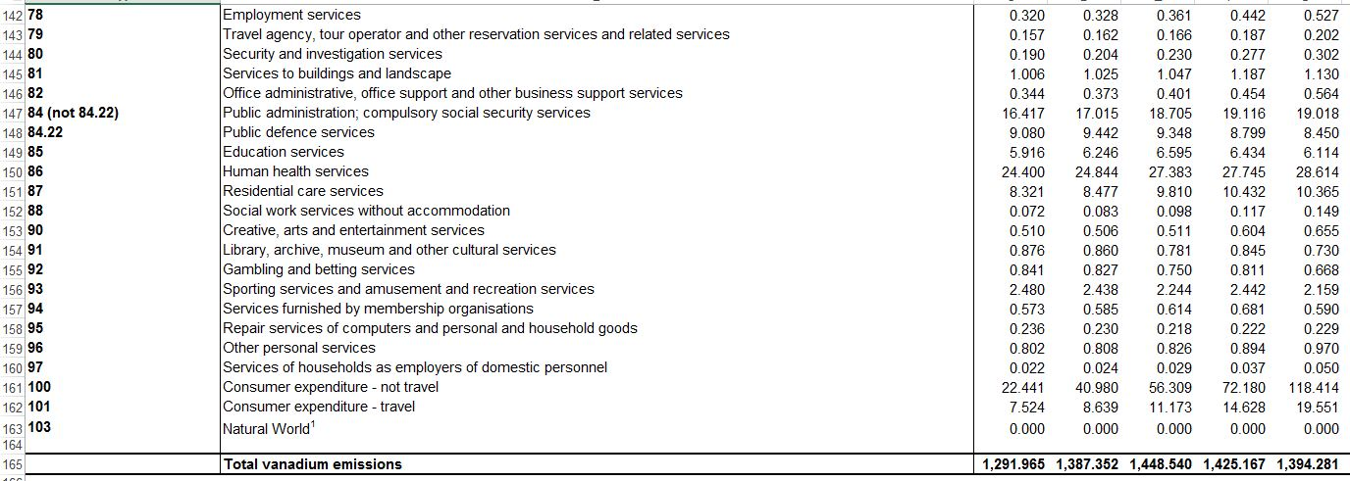
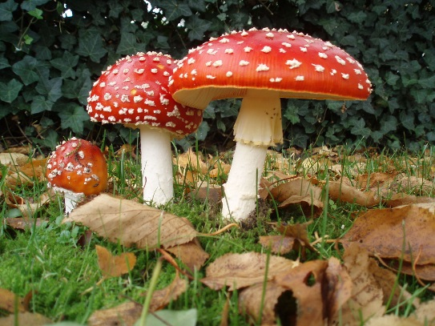

Slide 26
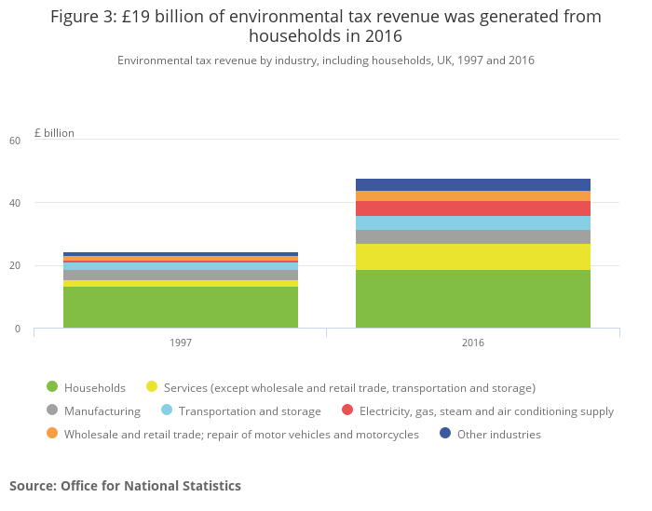

Slide 27
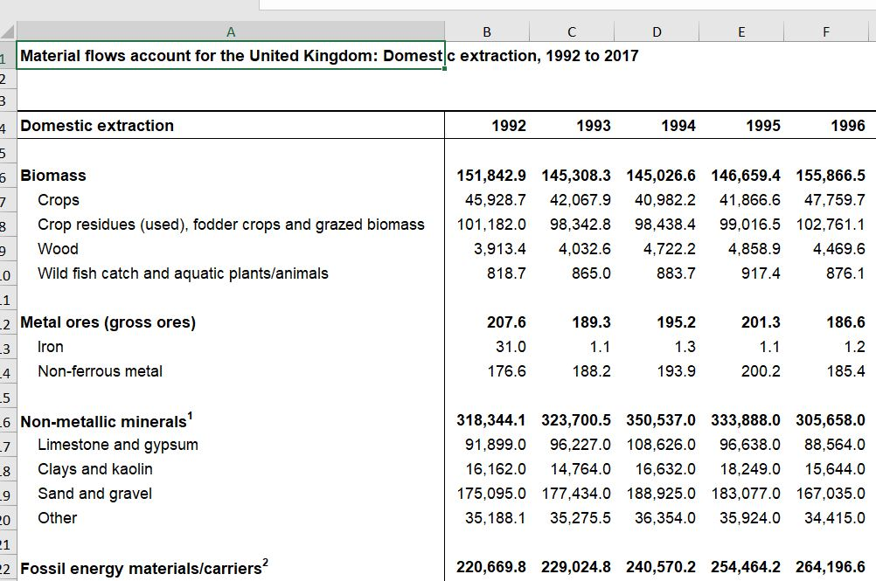

Slide 28
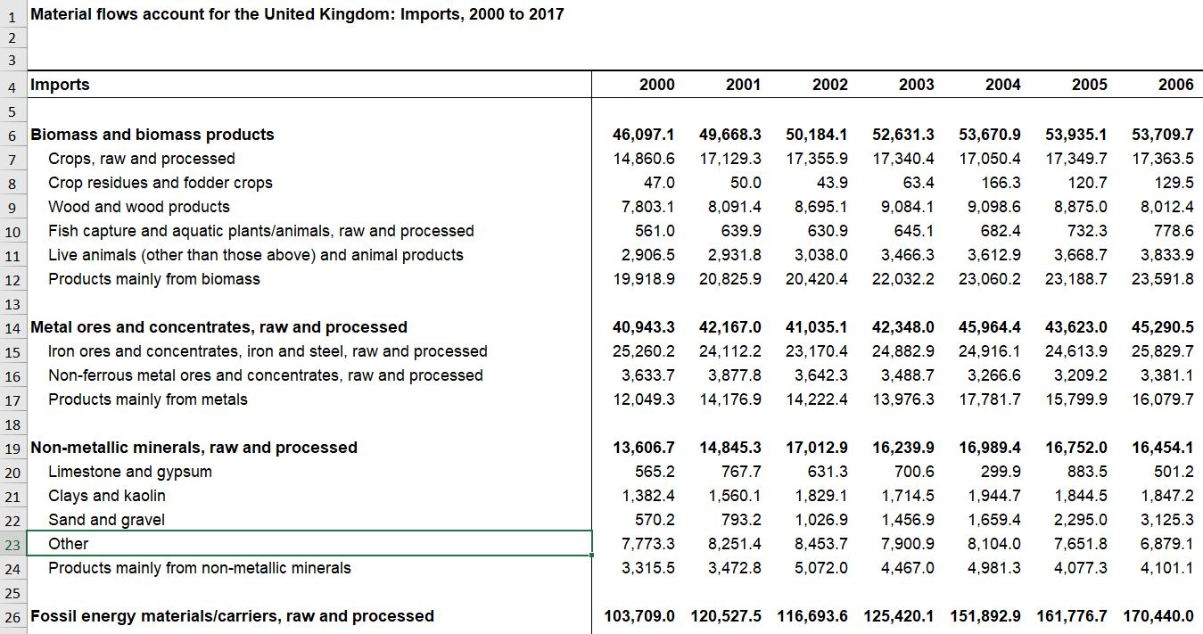

Slide 29
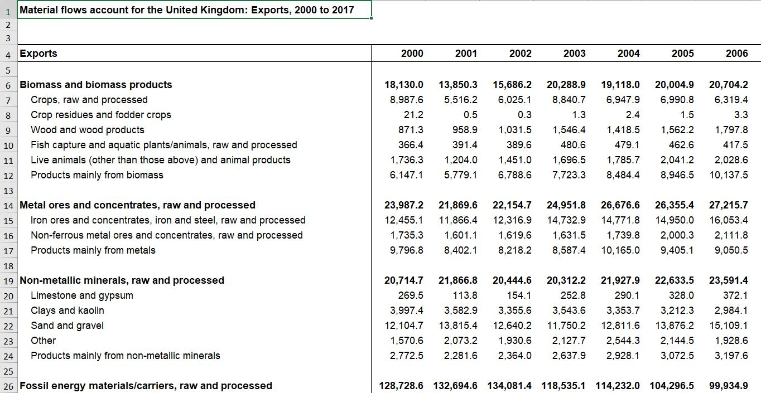

Slide 30
ONS Natural Capital Accounts
Annual value of services provided by nature for
Provisioning
Agriculture
Fishing
Timber
Mining
Regulating
Carbon sequestration
Air pollution removal
Noise mitigation
Cooling
Culture
Recreation
House prices
Notes:
Motivation for today’s lecture?
If you follow the news at all, you’ll hear a lot about three of the conventional measures of economic performance:
unemployment
inflation
and especially, GDP
Declining GDP means recession;
rising GDP is economic growth,
and economic growth is almost always presented as a wholly positive thing, and as a major goal of policy

Slide 31
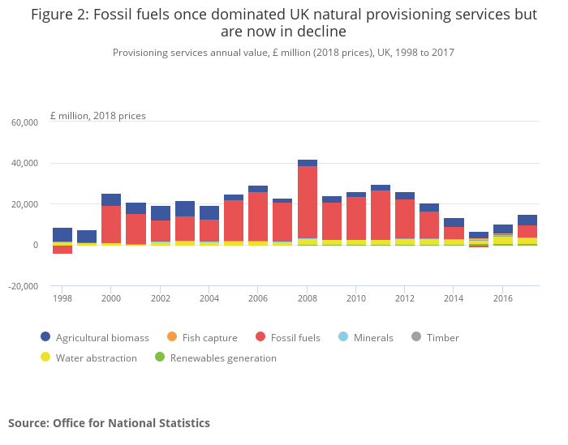

Slide 32
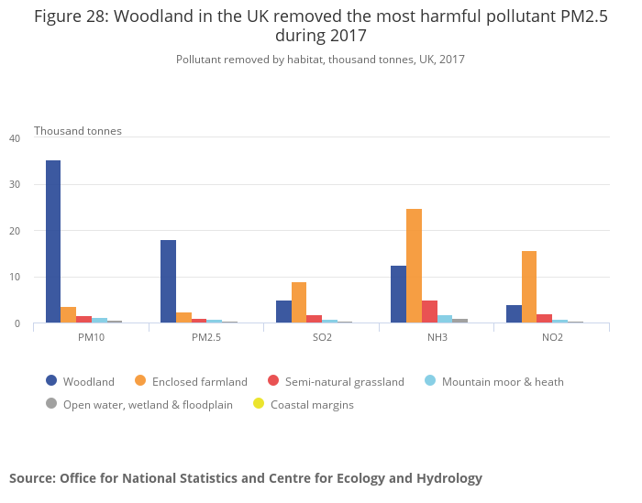

Slide 33
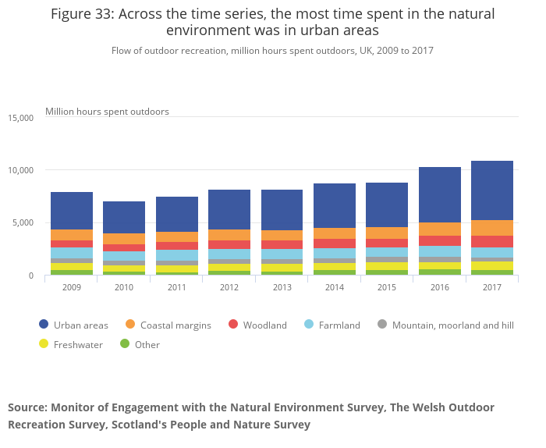

Slide 34
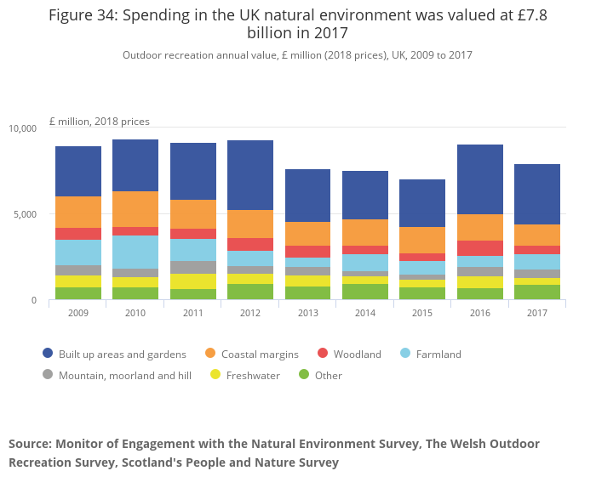

Slide 35
Green Accounting
GDP and its discontents
Productivity growth
Environmental product, theory
… and practice
Genuine savings
Alternative indicators
Ecological footprint
Corporate accounting

Slide 36
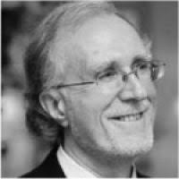
Genuine Savings
aka Adjusted Net Savings
World Bank’s sustainability measure
GS = Net investment in manufactured capital
Net depreciation of natural capital
+ Net investment in human capital
GS = Δ(EDP – C)
Measures investment in future consumption
Explicitly about capital, wealth
GS < 0 is unsustainable
GS ≥ 0 is weakly sustainable
Notes:
Our second real-world sustainability measure in this section is Genuine Saving.

Slide 37
GS = net investment in manufactured capital
– net depreciation of natural capital
+ net investment in human capital
Notes:
GS tries to operationalise the idea of measuring changes in total wealth.
Now, as we said earlier, measuring even just the changes in total wealth (and not even total wealth itself) is effectively impossible. So what GS sets out to measure is less than this: … (no social capital)

Slide 38
GS = – net investment in manufactured capital
– extraction of some fossil fuels and minerals, and forests – $20/ton emitted carbon – health damage costs of PM10
+ education spending (cap and op)
Notes:
But in practice, it currently does this:
education spending a very crude measure of human capital investment — but readily available in many countries over long periods

Slide 39
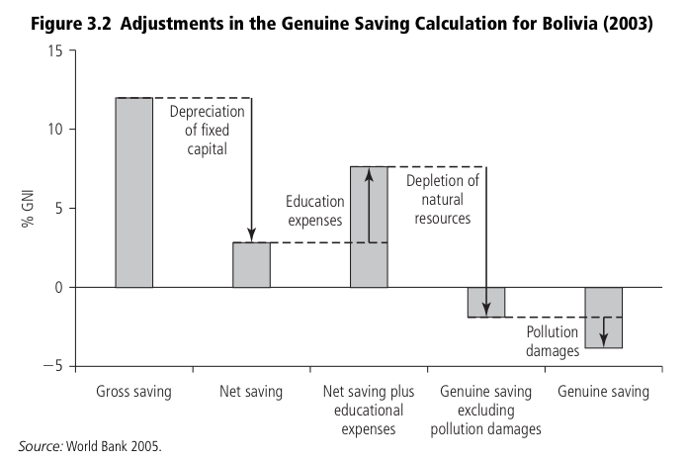
Notes:
Example calculation: Bolivia.
Not even weakly sustainable.

Slide 40
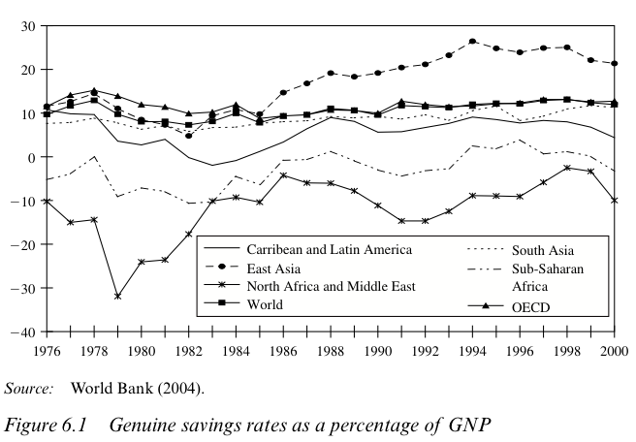
Notes:
Across world. Note: expressed as % of GNP. I.e. as a savings rate rather than simple savings.
East Asia high
North Africa and Middle East low

Slide 41
Adjusted net savings, 2016

Slide 42
What’s missing?
Natural capital
Fisheries
Soil erosion
Water pollution
Diamonds
…
but Wealth Accounting & Valuation for Ecosystem Services (WAVES)
Human capital
Depreciation (death)
…
Social capital
Investment efficacy
Notes:
Data issues. Need data for many countries over long periods. Some of these things are non-trivial to value. And there are hundreds of them.
But being worked on all the time…

Slide 43
Green Accounting
GDP and its discontents
Productivity growth
Environmental product, theory
… and practice
Genuine savings
Alternative indicators
Ecological footprint
Corporate accounting

Slide 44
Alternative indicators
Human development index
GDP per capita
Life expectancy at birth
Adult literacy rate (2/3), enrolment rate (1/3)
Scale from zero to one
Average
Ecological Footprint
Strong sustainability
Happy Planet Index
Life Satisfaction x Life Expectancy / Ecological Footprint
(2.7-8.0) x (44-75) / (0.02-100)
Notes:
Motivation for today’s lecture?
If you follow the news at all, you’ll hear a lot about three of the conventional measures of economic performance:
unemployment
inflation
and especially, GDP
Declining GDP means recession;
rising GDP is economic growth,
and economic growth is almost always presented as a wholly positive thing, and as a major goal of policy

Slide 45
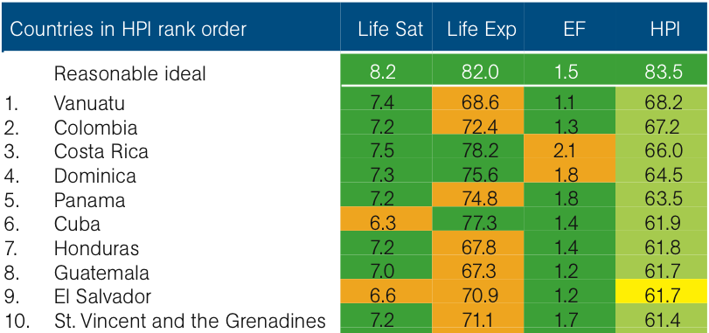
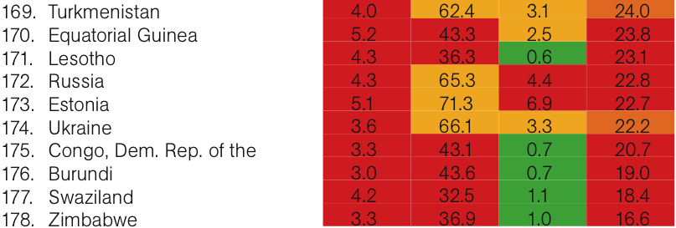
Notes:
Top 10 and bottom 10 countries, with a breakdown of their scores.
Generalisations we can draw from these: it’s good to be an island, and it’s good to be South American.
It’s bad to be formerly Communist, and it’s bad to have war or political instability.
Notice there are no really rich countries at the top of the list — because their EF is so high.

Slide 46
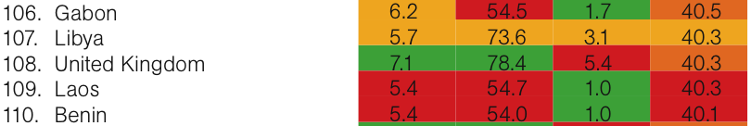
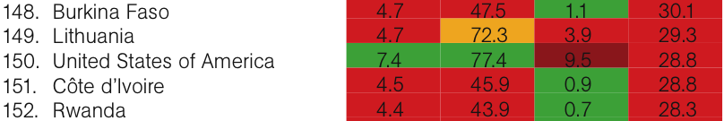
Notes:
Here are the UK and US, at 108 and 150 out of 178.
(EF = hectares/person?)
And this is the main point that the HPI brings across. The US and UK and other western democracies are on average the richest, healthiest and happiest nations
— but compared to many other countries in the world we are deeply inefficient (even wasteful) in turning the fruits of nature into happy healthy lives.

Slide 47
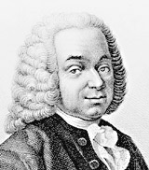
Ecological Footprint
Ecological limits embodied in land
“Appropriated carrying capacity”
Land area required to provide resources and assimilate wastes …
… vs. land area available
Physiocrats reborn
Wackernagel & Rees (1996)
Notes:
This is the idea behind the EF.
Embodies the idea of ecological limits in land area.
This is a bio-physical qty — unlike the capitals approach, where it’s all monetary, with no upper bound.
ACC = original title (Wackernagel’s PhD).
Sustainability would mean we’re not consuming more services than those that flow sustainably from the land available.

Slide 48
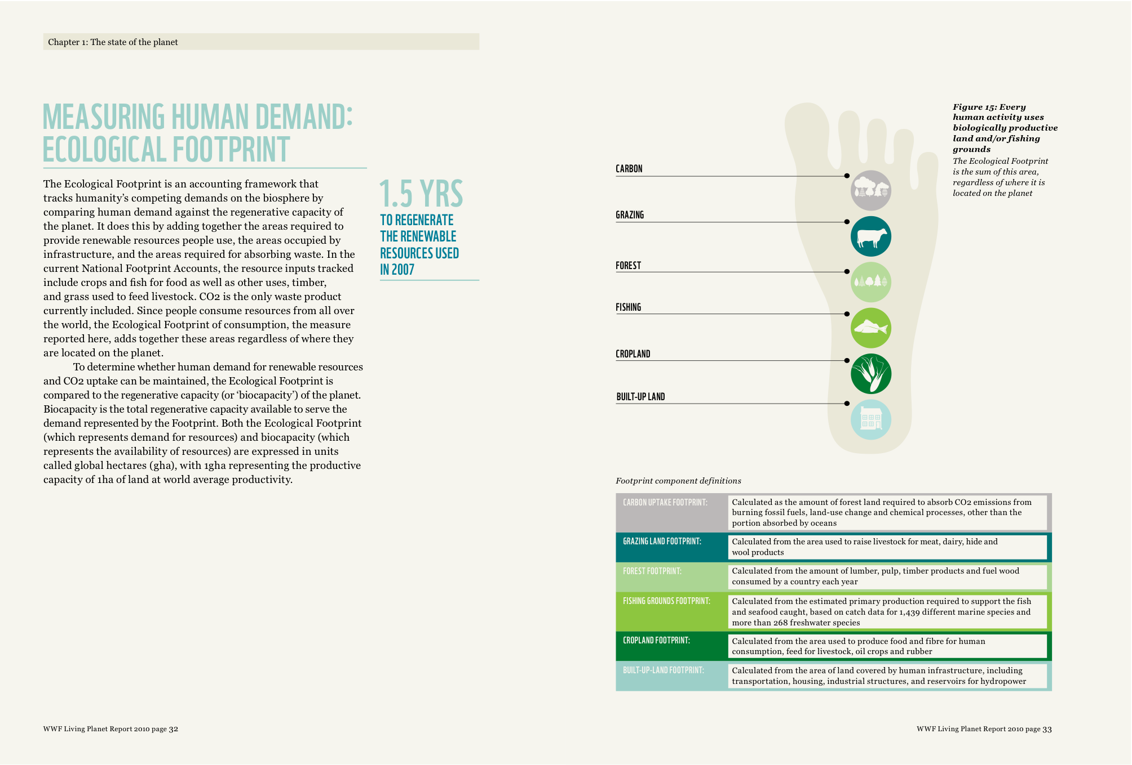
Notes:
WWF Living Planet reports give a nice summary of the components of the EF.
[go through it?]

Slide 49
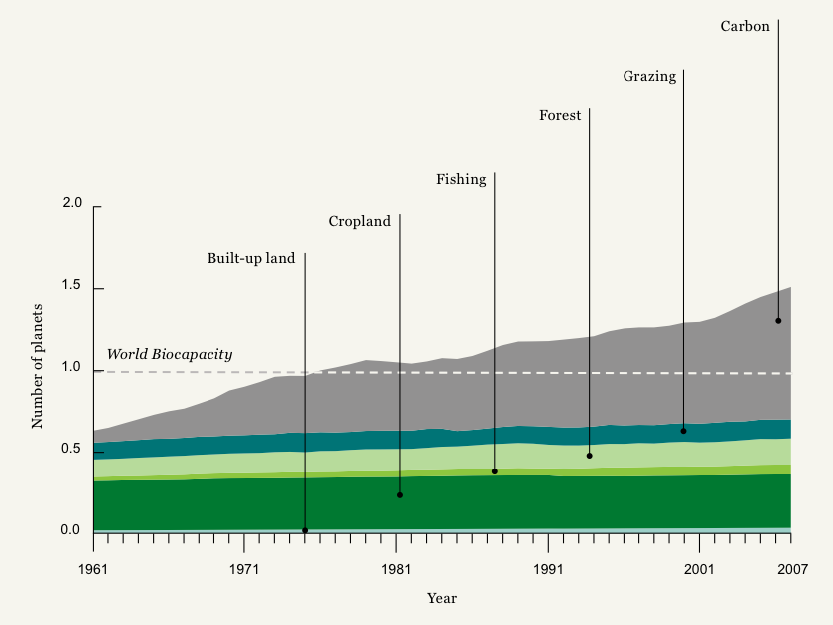
Notes:
1961 - 2007
Measure biocapacity in planet Earths — and we have exactly one.
Since the mid 70s we’ve been using more than one planet’s resources — i.e. taking more than just the interest on our natural capital.
And what’s pushed us over that threshold? Taking us back to last week’s topic: CO2. Everything else has increased only rather slowly.

Slide 50
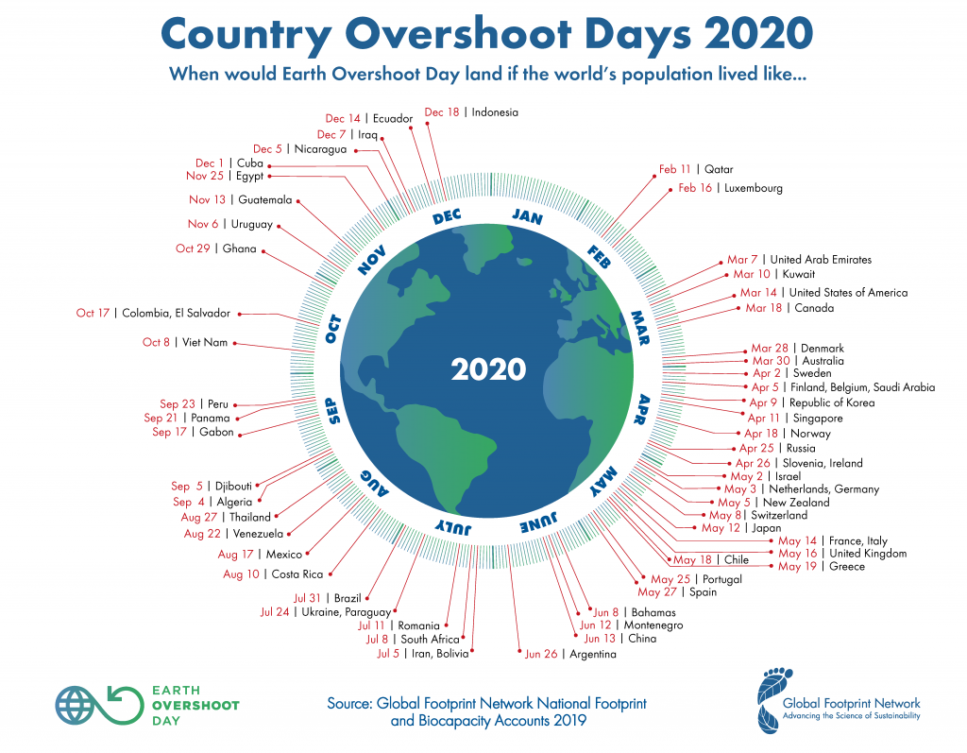

Slide 51
Fossil fuel combustion
More than half the global footprint
Awkward: Not about land
Accounted for by waste: Carbon dioxide
Amount of forest land needed to sequester
Why not amount of land for biofuel cultivation, wind turbines?
Why no other options to cut emissions, such as home insulation?
Notes:
Nuclear — took into account land around Chernobyl taken out of productive use to state that nuclear is equivalent to fossil fuels
Excellent for teaching and other communications.
Too tree-hugging for most economists!

Slide 52
Other limitations
Waste
Carbon only
Toxins? Nuclear waste?
Water
Whose land area?
Typically nation by nation
Autarky, anti-trade
Strong sustainability
But implies full substitutability between different kinds of natural capital
Notes:
Nuclear — took into account land around Chernobyl taken out of productive use to state that nuclear is equivalent to fossil fuels
Excellent for teaching and other communications.
Too tree-hugging for most economists!

Slide 53
Green Accounting
GDP and its discontents
Productivity growth
Environmental product, theory
… and practice
Genuine savings
Alternative indicators
Ecological footprint
Corporate accounting

Slide 54
Corporate Accounting
Companies report environmental performance to
(Prospective) customers
(Prospective) regulators
(Prospective) workers
(Prospective) investors
Notes:
Our second real-world sustainability measure in this section is Genuine Saving.

Slide 55
Milton Friedman on CSR
“The social responsibility of business is to increase its profits”
“… there is one and only one social responsibility of business to use its resources and engage in activities designed to increase its profits so long as it stays in the rules of the game, which is to say, engages in open and free competition, without deception or fraud.”
“A corporate executive … has direct responsibility to conduct business in accordance with [shareholder] desires …[i.e.] to make as much money as possible while conforming to their basic rules of the society, both those embodied in law and those embodied in ethical custom.”
Notes:
Our second real-world sustainability measure in this section is Genuine Saving.

Slide 56
Corporate Accounting
Companies report environmental performance to
(Prospective) customers
(Prospective) regulators
(Prospective) workers
(Prospective) investors
Five largest public companies in UK
HSBC
Unilever
BP
BHP Billiton
AstraZeneca
Notes:
Our second real-world sustainability measure in this section is Genuine Saving.

Slide 57
HSBC is focussed on the
environmental impact
of its investment portfolio
and loan book.

Slide 58
Unilever:
Good products,
good processes,
good employer

Slide 59
BP sets targets for its operational emissions, and reports on its performance.
Argues for climate policy.
No liability for use of its products.

Slide 60
BHP Billiton is focussed on
operational
performance.
Sustainability
report not just on
environment.

Slide 61
AstraZeneca is proud of its paper tigers.

Slide 62
Corporate Accounting
Lots of glossy material
Little standardization
You would be hard-pressed to discern which company does best, or which exceeds expectations
Sustainability reports are audited, but that just tells you that the reporting is truthful, not that the reporting is complete or useful
Certification imposes little discipline
Notes:
Our second real-world sustainability measure in this section is Genuine Saving.

Slide 63
Summary
Some progress towards environmental accounting of countries and companies
More numbers than insights
Notes:
Our second real-world sustainability measure in this section is Genuine Saving.

